Slide 1
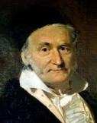
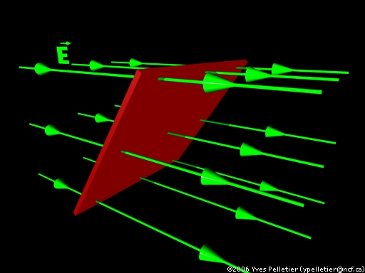
Section 3: Gauss’s Law

Slide 2
Carl Friedrich Gauss
Johann Carl Friedrich Gauss (30 April 1777 – 23 February 1855) was a German mathematician and physical scientist who contributed significantly to many fields, including number theory, statistics, analysis, differential geometry, geodesy, geophysics, electrostatics, astronomy and optics.

Slide 3

Electric Flux
Flux can be thought of as a “flow”
Flow of what??? Electric field!!

Slide 4
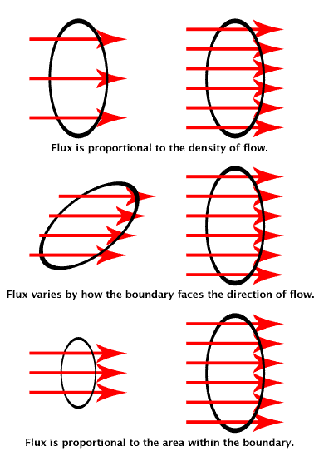
Flux as flow

Slide 5
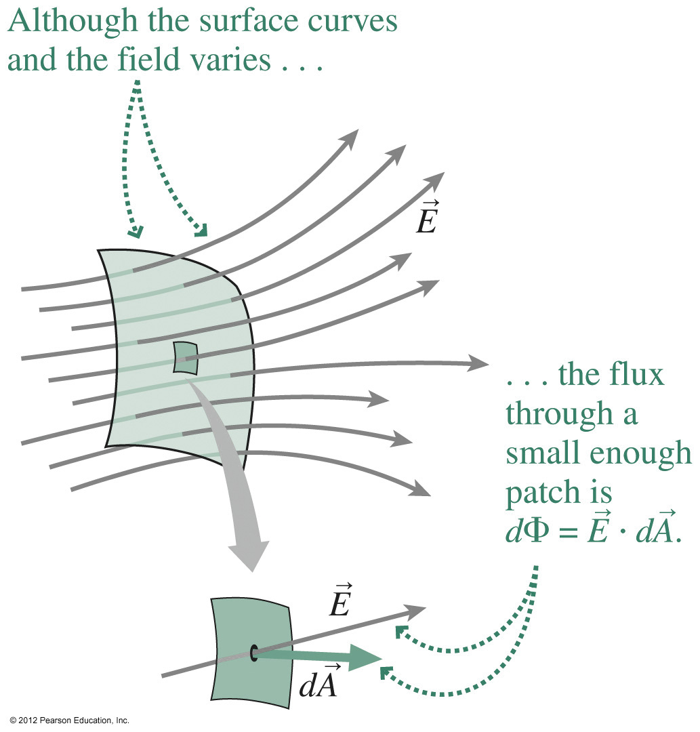
Flux and Surface

Slide 6
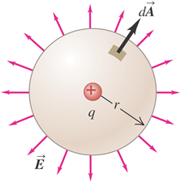

Calculating Flux: General Case
$$Φ_{E}≡\int{\vec{E}}∙d\vec{A}$$

Slide 7
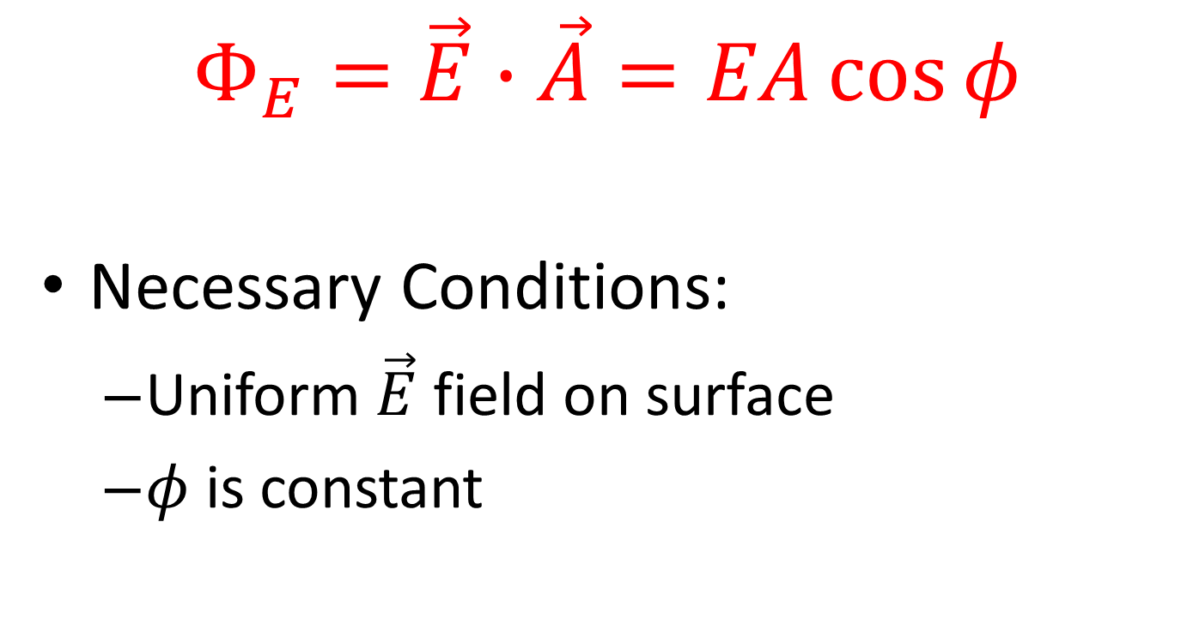
Calculating Electric Flux
$$Φ_{E}=\vec{E}∙\vec{A}=EA\cos{φ}$$
Necessary Conditions:
Uniform $\vec{E}$ field on surface
$φ$ is constant

Slide 8
Example Problem I

Slide 9
Activity: Electric Flux

Slide 10
Example II

Slide 11
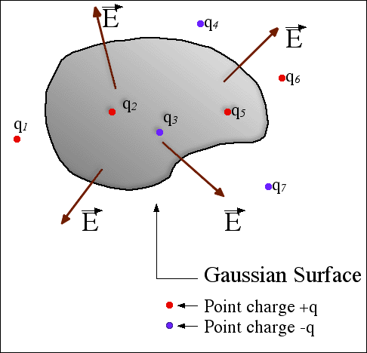
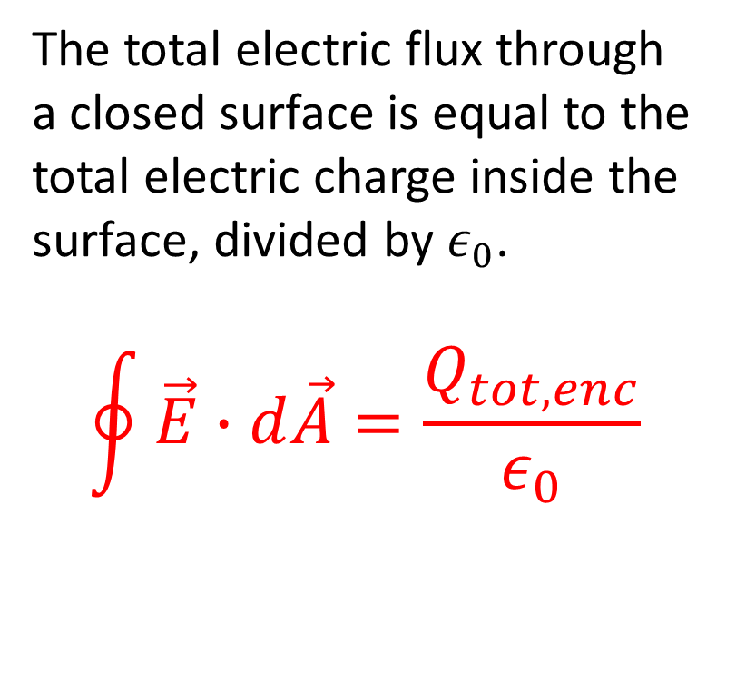
Gauss’s Law
The total electric flux through a closed surface is equal to the total electric charge inside the surface, divided by $ε_{0}$.
$$\oint{\vec{E}}∙d\vec{A}=\frac{Q_{tot,enc}}{ε_{0}}$$

Slide 12
Gauss’s Law Examples

Slide 13
Activity: Gauss’s Law

Slide 14
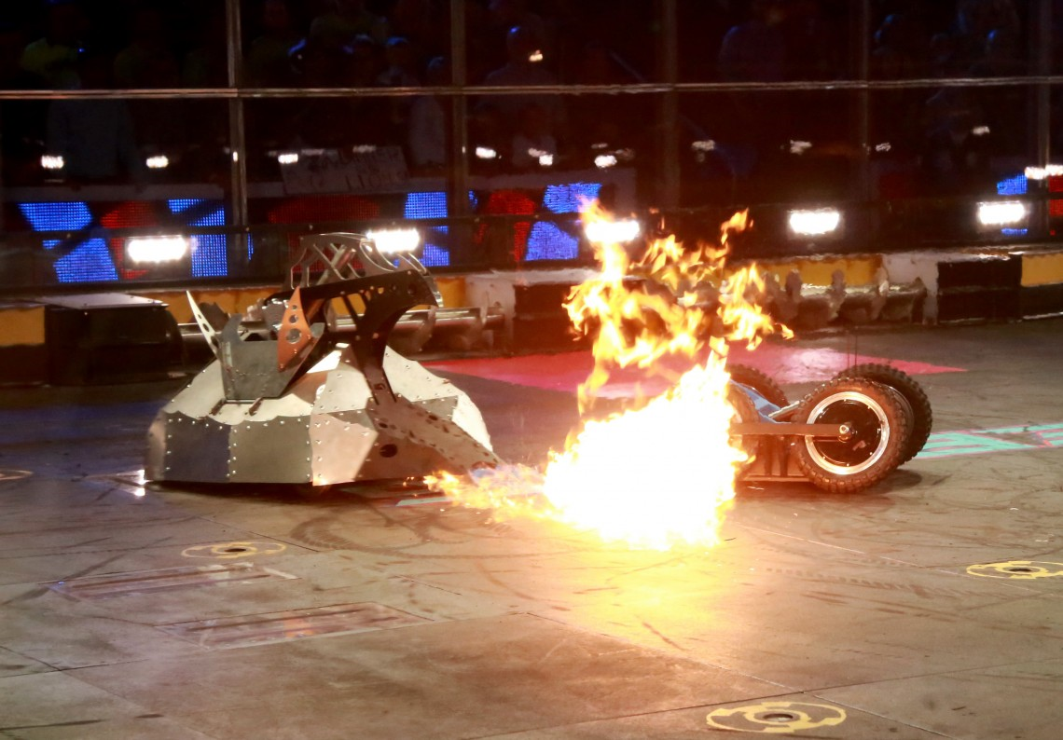
LONE STAR ENGINEERING SOCIETY
Meetings: Thursday 3-4 B 112
If interested, email lscm.engr@gmail.com

Slide 15
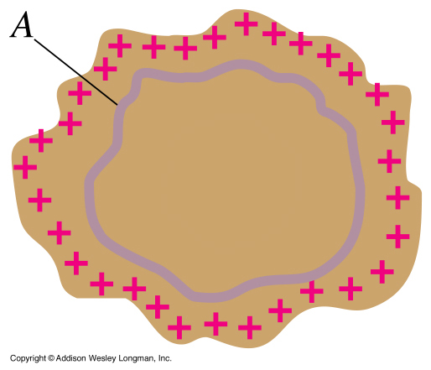

Electric Field, Charges and Conductors
$E=0$ inside a conductor (why??)
Use Gauss’ Law to figure out where charge is!

Slide 16
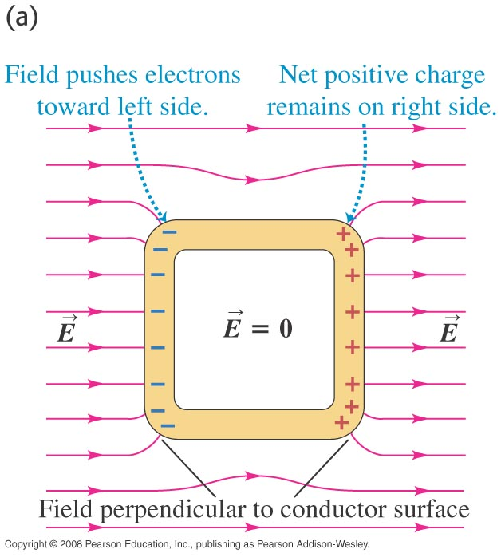
Cavities of Conductors

Slide 17
